Slide 1
Brighton Snow Safety Patrol refresher 20-21
By – peter tucker

Slide 2
Goals - 19-20 season review, by the numbers - Avalanche mitigation operational Mornings timeline - Avalanche Mitigation routes, route safety, and log/shot sheets
Bottom lines and takeaways video at end

Slide 3
2019-2020 season review
Oct. - 33” snow @ 2.83” H2O…..aka Snow Water Equivalent (SWE)
Nov. - 70” snow @ 4.85” H2O
Dec. - 84” snow @ 7.37” H2O
Jan. - 152.5” snow @ 10.44” H20
Feb. - 56.5” snow @ 5.59” H20
Mar. - 82.5” snow @ 6.86” H2O
Apr. - 34” snow @ 3.13” H2O
Year to Date (YTD) 502.5” snow @ 41.02” H20

Slide 4
Past 20 years snow and water totals 00-01 – 473.5” @ 43.85” H2O 01-02 – 425” @ 41.37” H20 02-03 – 359” @ 33.35” H2o 03-04 – 508” @ 39.27” h2o 04-05 – 627.5” @ 60.25” h2o 05-06 – 667” @ 62.65” h2o 06-07 – 418.5”@ 37.54” h2o 07-08 – 644.5” @ 52.37” h2o 08-09 – 591.5” @ 52.82” h2o 09-10 – 537” @ 46.03” H2o 10-11 – 686” @ 70.35” h2o 11-12 – 364.5” @ 36.37” h20 12-13 – 417” @ 34.75” h2o 13-14 – 423” @ 38.25” h2o 14-15 – 295” @ 25.27” h20 15-16 – 464.75” @ 38” h20 16-17 – 674” @ 60.94” h20 17-18 – 354” @ 31.83” h20 18-19 – 651” @ 56.85” H20 19-20 – 502.5” @ 41.02” H2o

Slide 5
Storms by the Numbers 10” or more storms – 13x 20” or more storms – 4x 0 storms in the 30-40” range 40” or more storms – 2x 50” or more storms – 1x 3 separate storms with less then a 24-hour window between them produced 78” of snow

Slide 6
Most Significant cycles Thanksgiving cycle, 11-27—30, 2019 - 57” @ 3.88” H2o mid December cycle, 12-12---16, 2019 - 42.5” @ 3.98” h20 mid January cycles, 1-8---15, 2020 - 78” @ 3.99” H20 LCC inner lodge cycle, 2-6—9, 2020 - 20.5” @ 2.82” H20

Slide 7
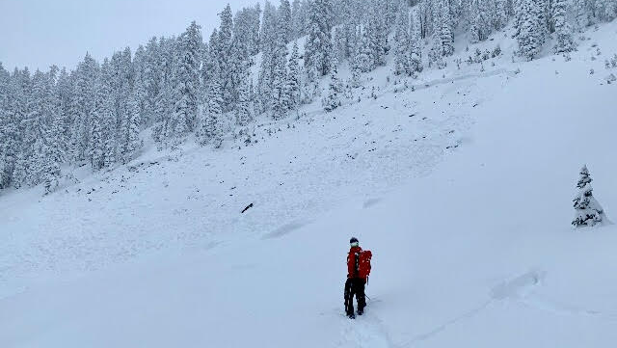
Thanksgiving cycle, Snake Creek Bowl
Significant cracking on ascent, peppered the slope, came around the corner to this.

Slide 8
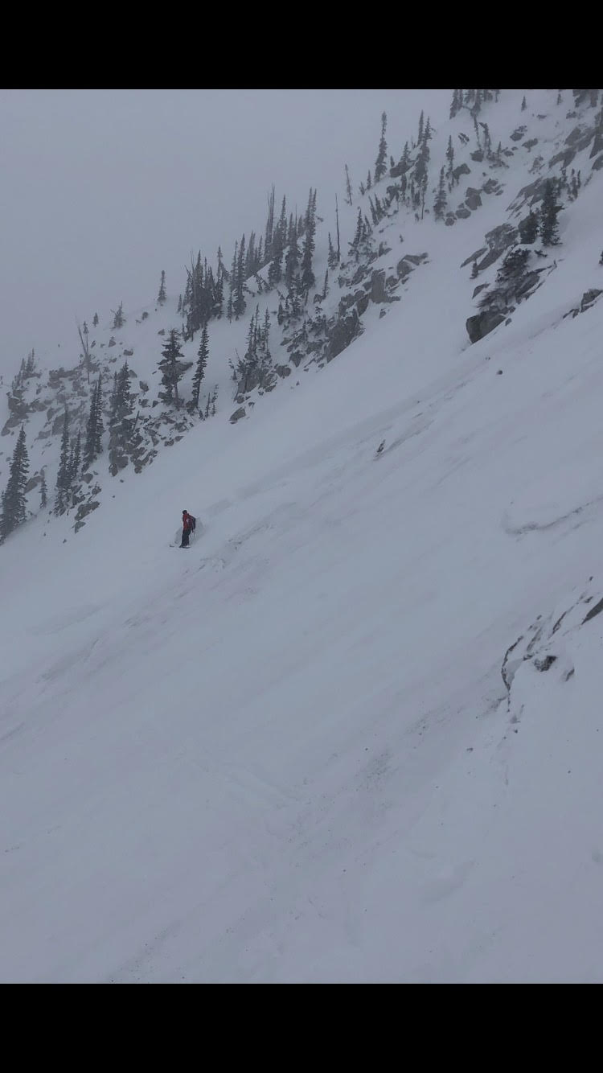
February LCC inner lodge cycle, 2-7-20
Chris Stowe making his way across Milly bowl. High density snow with winds created very reactive slabs, crowns ranged from 18”-4’.

